Slide 1

Introduction to Machine Learning Lesson 1 hands on
Christina Simbenga

Slide 2
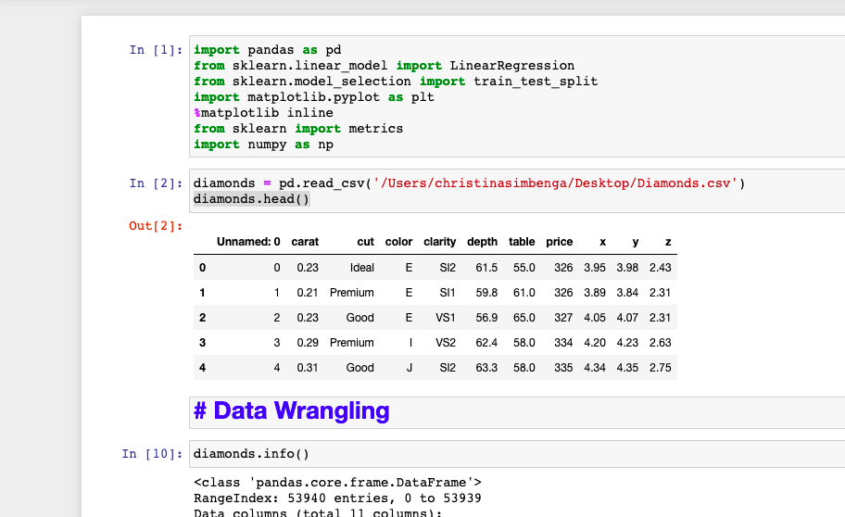
Looking at the Diamonds data

Slide 3
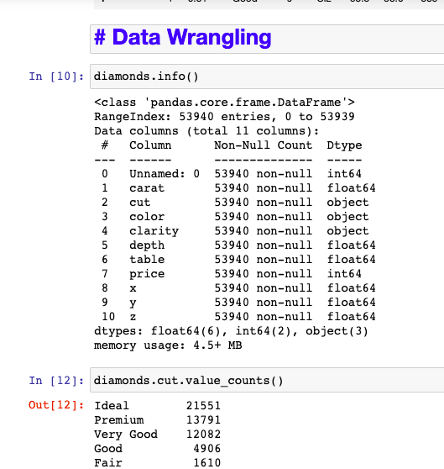
Lots of data wrangling
I went through the data and looked at the columns I needed to use and recode so that they have number instead of strings.

Slide 4
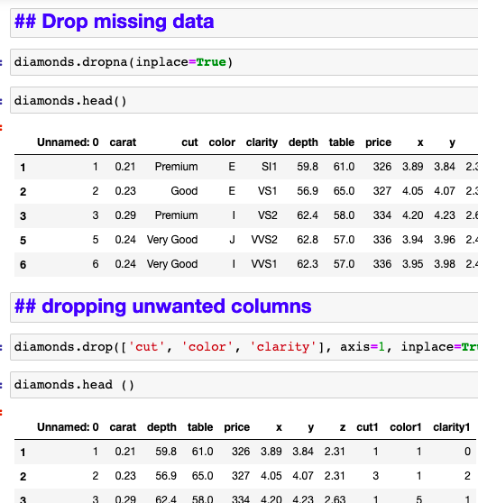
Dropping columns and missing data
I had to drop some missing data so they won’t affect the overall test. Also, I got ride of the old columns with strings so the data can look prettier

Slide 5
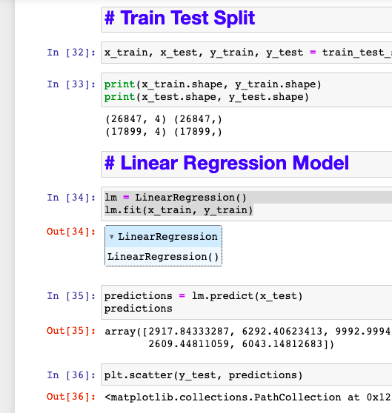
Train test and Linear Regression
After Wrangling the data I completed the train test and checked for linear regression by completing the scatterplot.

Slide 6
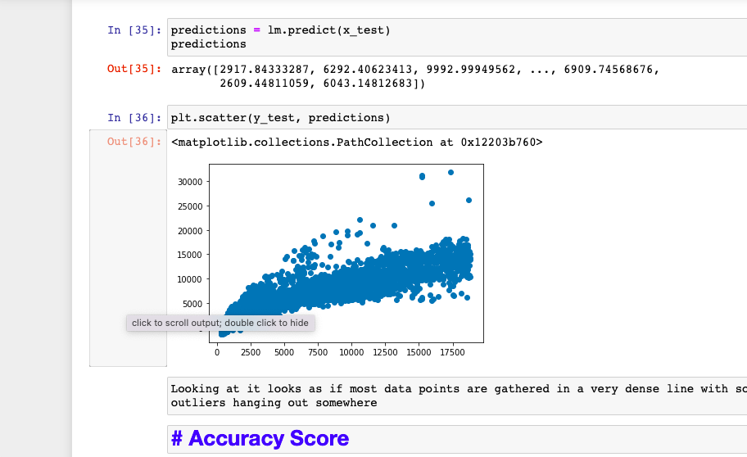
Scatter plot

Slide 7
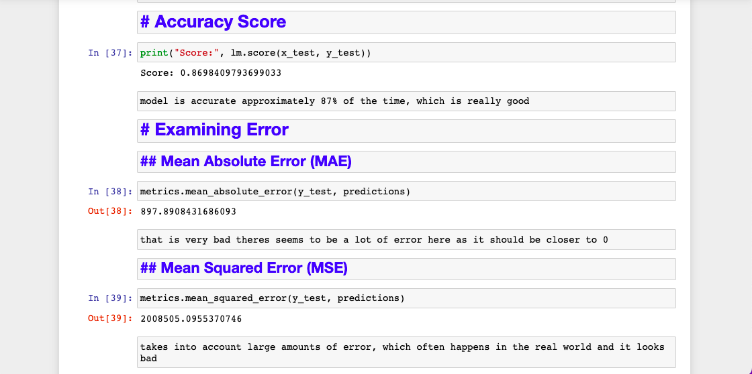
Accuracy and Error test
I looked at the accuracy score and it showed 87% of the time model is accurate
I looked at the errors and they were very large numbers when it should have been towards ”0”. There are a lot of errors in the model

Slide 8
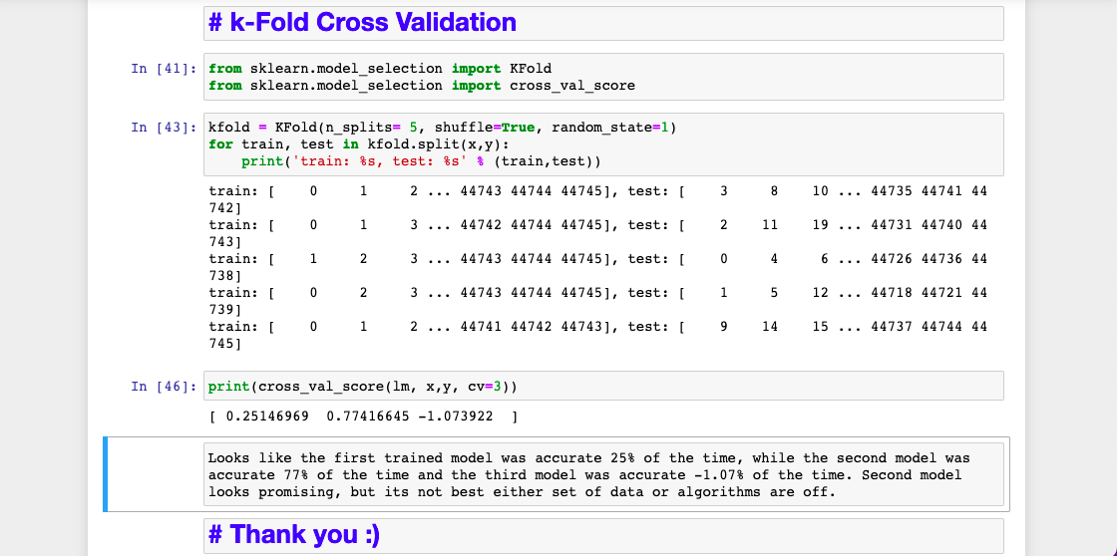
K fold cross validation
Looks like the first trained model was accurate 25% of the time, while the second model was accurate 77% of the time and the third model was accurate -1.07% of the time. Second model looks promising, but its not best either set of data or algorithms are off.

Slide 9
Thank you

